Slide 1


Front End Basics
SoftUni Team
Technical Trainers
Software University
http://softuni.bg

Slide 2
Table of Contents
JavaScript
What’s JavaScript?
Functions
jQuery
Bootstrap
Grid system
Bootstrap components

Slide 3
Have a Question?
sli.do #java-web

Slide 4
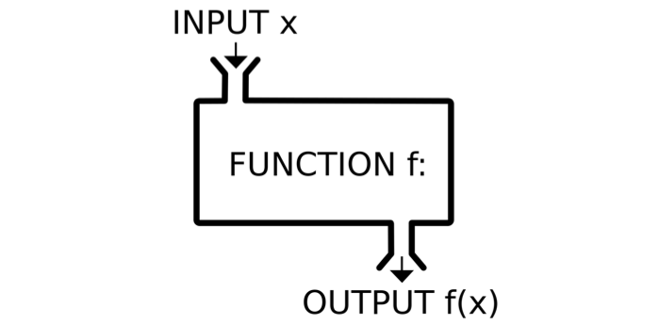
JavaScript
Functions - Syntax, Invocation, Return, Functions as values

Slide 5
JavaScript Syntax
The JavaScript syntax is similar to C#, Java and PHP
Operators, Variables, Conditional statements, loops,
functions, arrays, objects and classes
Declare a variable with let
let a = 5;
let b = 10;
if (b > a) {
console.log(b);
}
Body of the conditional statement
Conditional statement

Slide 6
Functions in JS
Why Functions?
You can reuse code, define once, use many times.
Function = block of code
Can take parameters and return result
Function name: use camelCase
Function parameters: use camelCase
function printStars(count) {
console.log("*".repeat(count));
}
The { stays at the same line
Invoke the function
printStars(10);

Slide 7
Functions in JS (2)
function sum (a, b) {
console.log(a + b);
}
sum (5, 6); // 11
Invoke the function with different parameters value
function sum (a, b = 3) {
console.log(a + b);
}
sum (11); // 14
Default function parameters
function sum (a, b) {
return a + b;
}
let c = sum (5.8, 3);
console.log (c); // 8.8
Return ends function execution

Slide 8
Function Declaration, Expression, Arrow
function walk() {
console.log('walking');
}
walk(); // walking
Function Declaration
let solve = function walk() {
console.log('walking');
}
solve(); // walking
Function Expression
let solve = () => {
console.log('walking');
}
solve(); // walking
Arrow function

Slide 9
Function Invocation
The code inside a function is executed when the function is invoked with () operator
Invoke the function after declaration
function write(name) {
console.log(`I am ${name}`);
}
write('George'); // I am George
write('George'); // I am George
function write(name) {
console.log(`I am ${name}`);
}
Invoke the function before declaration

Slide 10
Function Invocation (2)
Anonymous self-invoking function
(function (count) {
for (let i = 1; i <= count; i++)
console.log('+'.repeat(i));
})(4);
+
++
+++
++++
This is called "closure" (a state is closed inside)
let f = (function () {
let x = 0;
return function() { console.log(++x); }
})(); f(); f(); f(); f();
1
2
3
4

Slide 11
Function Return
Return statement ends function execution
function getRectArea(width, height) {
if (width > 0 && height > 0) {
return width * height;
}
return 0;
}
console.log(getRectArea(3, 4)); // 12
console.log(getRectArea(-3, 4)); // 0
let result = function (a, b) {
return a % b;
};
console.log(result(10, 3)); // 1

Slide 12
Variables Holding Functions
In JS variables can hold functions as their values
let f = function(x) { return x * x; }
console.log(f(3)); // 9
console.log(f(5)); // 25
f = function(x) { return 2 * x; }
console.log(f(3)); // 6
console.log(f(5)); // 10
f = undefined;
console.log(f(3)); // TypeError: f is not a function(…)

Slide 13
Functions as Parameters
function repeatIt(count, func) {
for (let i = 1; i <= count; i++)
func(i);
}
let starsFunc = function(i) {
console.log('**'.repeat(i))
};
repeatIt(3, starsFunc);
repeatIt(3, function(x) {
console.log(2 * x);
});
**
****
******
2
4
6

Slide 14

jQuery

Slide 15
What is jQuery?
Cross-browser JavaScript library
Dramatically simplifies DOM manipulation
Simplifies AJAX calls and working with RESTful services
Free, open-source software: https://jquery.com
<script src="https://code.jquery.com/jquery-3.1.1.min.js"></script>
Load jQuery from its official CDN
$('li').css('background', '#DDD');
Change the CSS for all <li> tags

Slide 16
Using jQuery from CDN
<script src="https://code.jquery.com/jquery-
3.1.1.min.js" integrity="sha256-
hVVnYaiADRTO2PzUGmuLJr8BLUSjGIZsDYGmIJLv2b8=
"crossorigin="anonymous"></script>
$(function() {
$("a").on('click', (event) => {
alert("Link forbidden!");
event.preventDefault();
});
});

Slide 17
jQuery Selectors
jQuery selection is the same as the querySelector in Vanilla JS
All selector
Class selector
Element selector
Id selector
Multi-selector
$('*') // Selects all elements
$('.class') // Select by class name
$('section') // Select by tag name
$('#id') // Selects a element by given id
$('selector1, selector2') // Combined

Slide 18
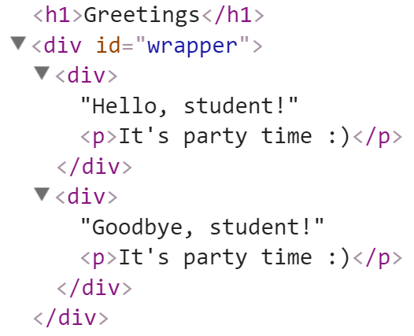
Adding Elements with jQuery
Select the parent element, then use:
append() / prepend()
appendTo() / prependTo()
<div id="wrapper">
<div>Hello, student!</div>
<div>Goodbye, student!</div>
</div>
$('#wrapper div').append("<p>It's party time :)</p>");
$('<h1>Greetings</h1>').prependTo('body');

Slide 19
Creating / Removing Elements
let div = $('<div>');
div.text('I am a new div.');
div.css('background', 'blue');
div.css('color', 'white');
$(document.body).append(div);
let paragraph = $('<p>Some text</p>');
paragraph.appendTo(div);
$('div').remove();

Slide 20
jQuery Events: Attach / Remove
Attaching events on certain elements
$('a.button').on('click', buttonClicked);
function buttonClicked() {
$('.selected').removeClass('selected');
$(this).addClass('selected');
// "this" is the event source (the hyperlink clicked)
}
Removing event handler from certain elements
$('a.button').off('click', buttonClicked);

Slide 21

Bootstrap

Slide 22
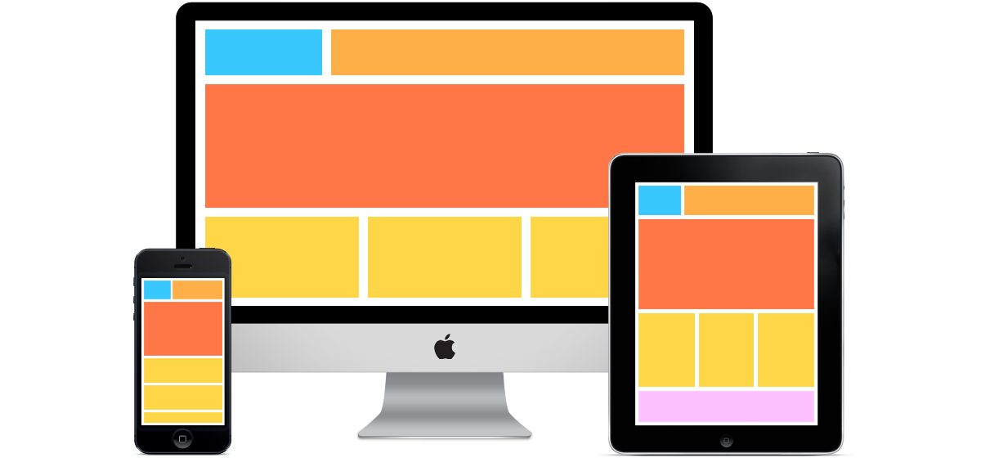
What is a Responsive Design?
Presentation layers that adjust according to the screen size of the different devices
Desktop layouts
Tablet layouts
Mobile layouts

Slide 23

Bootstrap
World's most popular front-end component library
Open source toolkit for developing with HTML, CSS, and JS
Works with
Responsive grid system
Extensive prebuilt components
Powerful plugins built on jQuery

Slide 24
Include from a BootstrapCDN – JS
Be sure to place jQuery and Tether first, as the Bootstrap code depends on them
JavaScript, Popper.js and jQuery
<script src="https://code.jquery.com/jquery-3.3.1.slim.min.js></script>
<script src="https://cdnjs.cloudflare.com/ajax/libs/tether/1.4.0/js/tether.min.js"></script>
<script src="https://stackpath.bootstrapcdn.com/bootstrap/4.1.2/js/bootstrap.min.js></script>

Slide 25
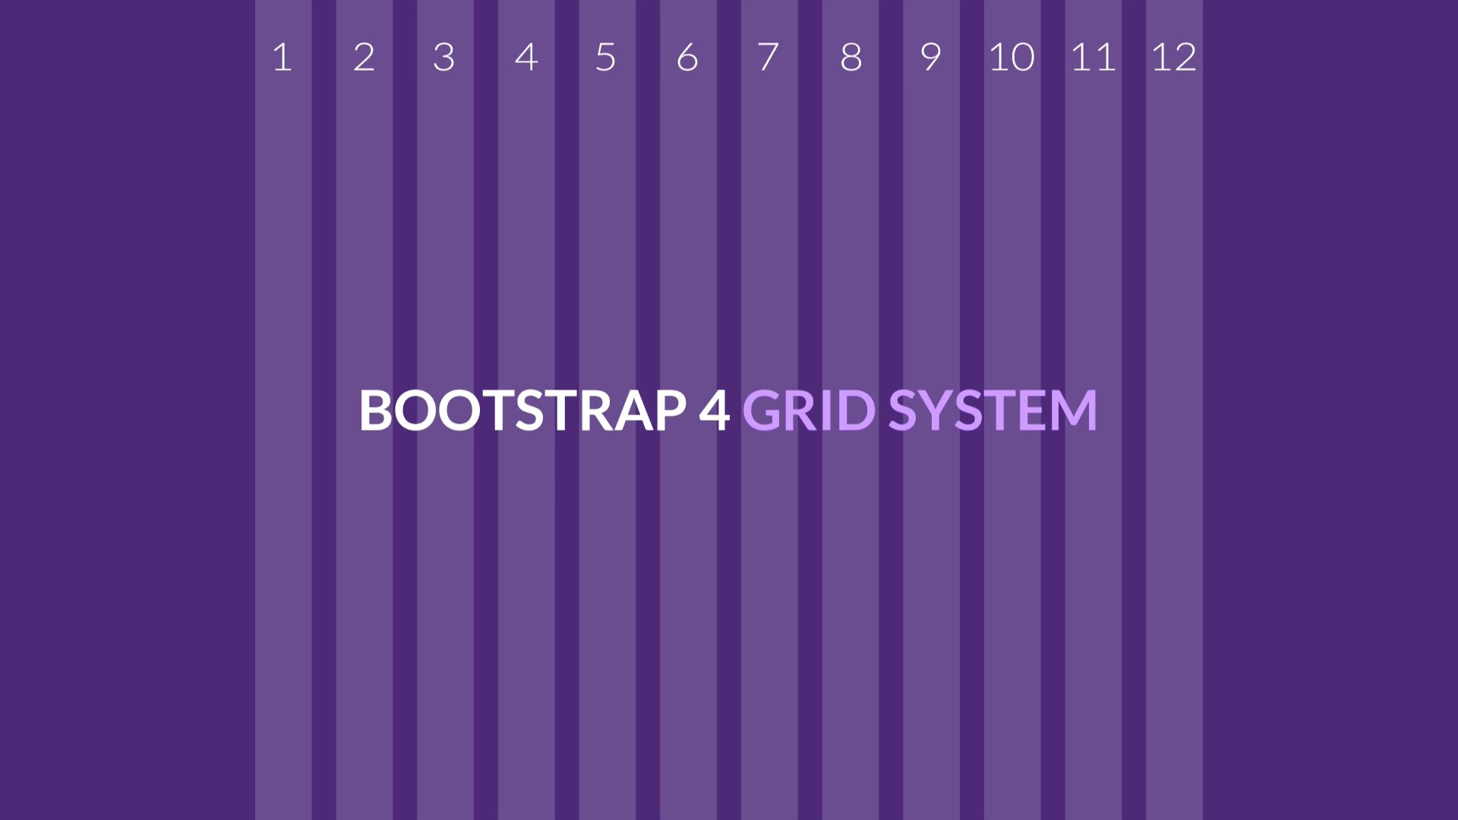
Bootstrap Grid System
Build layouts with grid - twelve column system

Slide 26

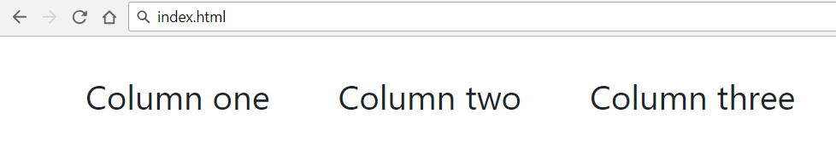
Bootstrap Grid System Demo
index.html
…
<div class="container">
<div class="row">
<div class="col-xs m-3">Column one</div>
<div class="col-xs m-3">Column two</div>
<div class="col-xs m-3">Column three</div>
</div>
</div>
…
Container
Row
Columns

Slide 27
Bootstrap Containers
Rows must be placed in containers
.container has one fixed width for each screen size in bootstrap (xs,sm,md,lg)
.container-fluid expands to fill the available width
Responsive pixel width
width: 100%

Slide 28

Column Classes
Determines how many columns to use on different screen sizes
.col-xs: width less than 768px
.col-sm: width between 768px and 992px
.col-md: width between 992px and 1200px
.col-lg: width over 1200px
index.html
<div class="col-sm-8 col-lg-4">Column one</div>
<div class="col-sm-2 col-lg-4">Column two</div>
<div class="col-sm-2 col-lg-4">Column three</div>

Slide 29
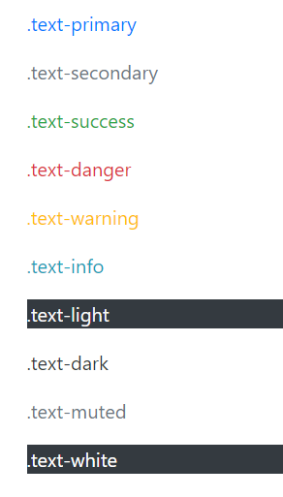
Color
Handful of color utility classes
index.html
<p class="text-primary">.text-primary</p>
<p class="text-secondary">.text-secondary</p>
<p class="text-success">.text-success</p>
<p class="text-danger">.text-danger</p>
<p class="text-warning">.text-warning</p>
<p class="text-info">.text-info</p>
<p class="text-light bg-dark">.text-light</p>
<p class="text-dark">.text-dark</p>
<p class="text-muted">.text-muted</p>
<p class="text-white bg-dark">.text-white</p>

Slide 30
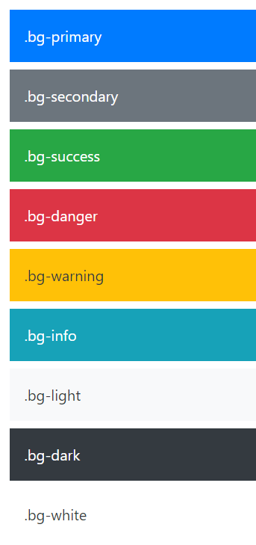
Background Color
Easily set the background of an element to any contextual class
index.html
<div class="bg-primary text-white">.bg-primary</div>
<div class="bg-secondary text-white">.bg-secondary</div>
<div class="bg-success text-white">.bg-success</div>
<div class="bg-danger text-white">.bg-danger</div>
<div class="bg-warning text-dark">.bg-warning</div>
<div class="bg-info text-white">.bg-info</div>
<div class="bg-light text-dark">.bg-light</div>
<div class="bg-dark text-white">.bg-dark</div>
<div class="bg-white text-dark">.bg-white</div>

Slide 31
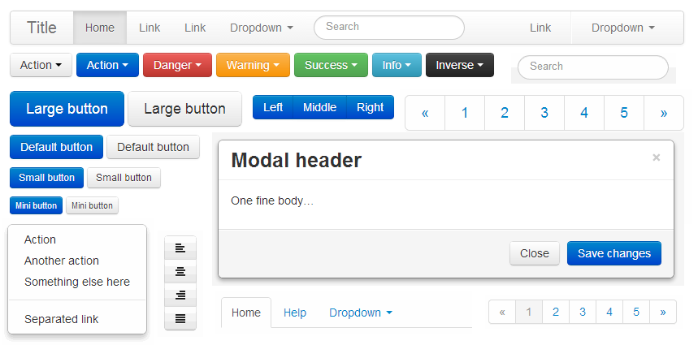
Bootstrap Components
Over a dozen reusable components

Slide 32
Button Groups
Custom button styles with support for multiple sizes, states, and more
index.html
<button type="button" class="btn btn-primary">Primary</button>
<button type="button" class="btn btn-secondary">Secondary</button>
<button type="button" class="btn btn-success">Success</button>
<button type="button" class="btn btn-danger">Danger</button>
. . .
Documentation: https://getbootstrap.com/docs/4.0/components/buttons/

Slide 33
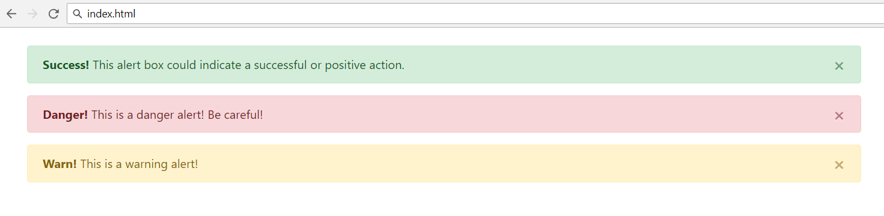
Alerts
Provide contextual feedback messages for typical user actions with the handful of flexible alert messages
<div class="alert alert-success alert-dismissable">
<a class="close" data-dismiss="alert" aria-label="close">×</a>
<strong>Success!</strong> This alert box could indicate a successful or positive action.
</div>
…

Slide 34
Nav and Navbar
Require a wrapping .navbar
Responsive by default
Come with built-in support for a handful of sub-components
.navbar-brand for your company, product, or project name
.navbar-nav for a full-height and lightweight navigation
.nav-item for every item in navigation
See more at: https://getbootstrap.com/docs/4.0/components/navbar/

Slide 35
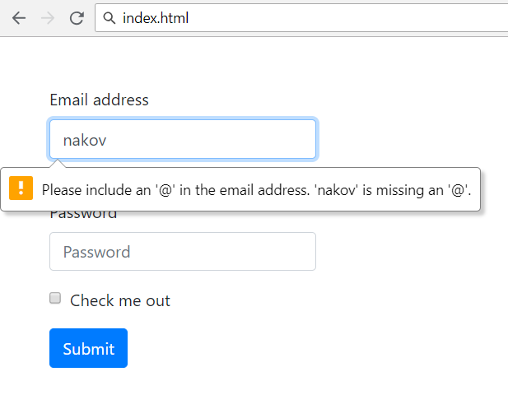

Forms
Form control styles, layout options and custom components for creating a wide variety of forms
Use type attribute on all inputs to take advantage of newer input controls
Email verification
Number selection

Slide 36
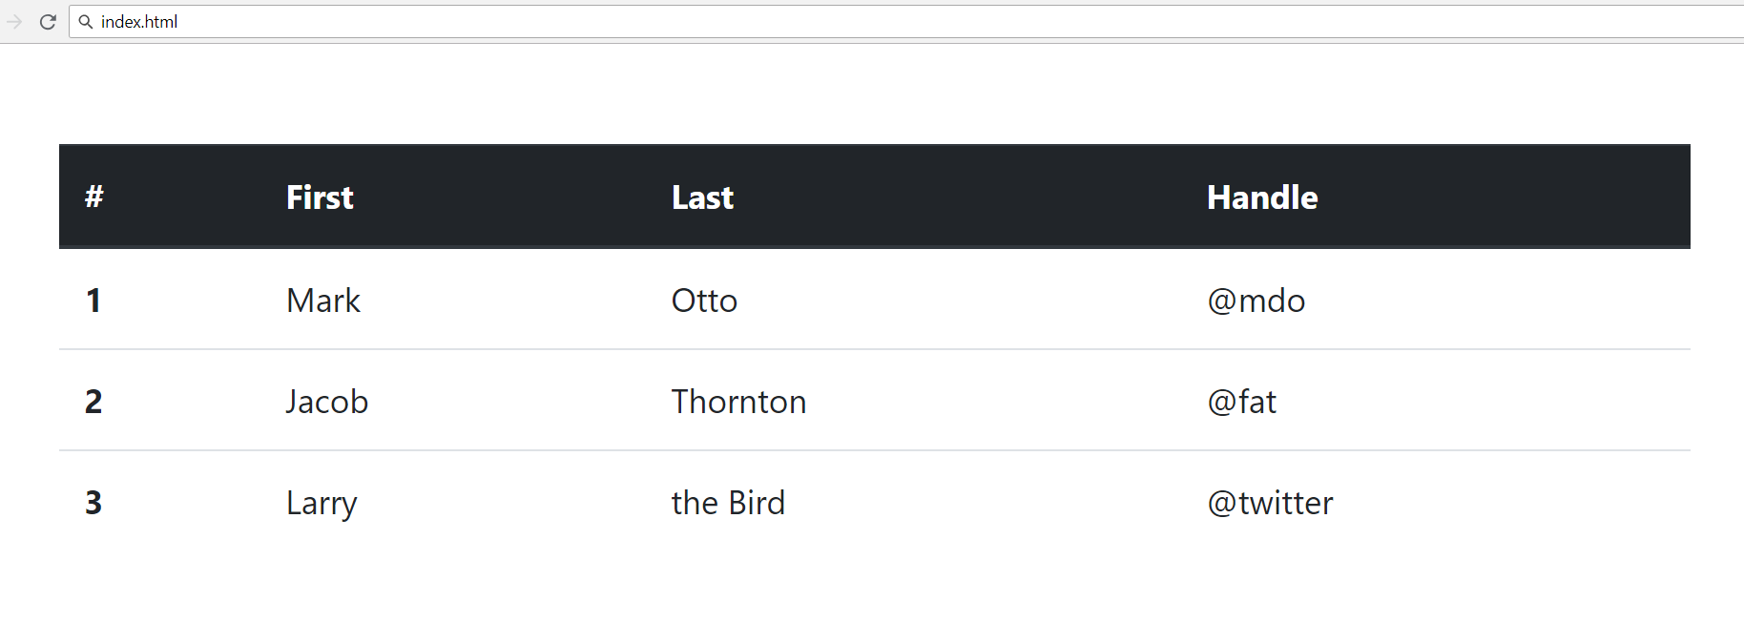
Tables
<table class="table">
<thead class="thead-dark">
<tr> <th scope="col">#</th>
<th scope="col">First</th>
<th scope="col">Last</th>
<th scope="col">Handle</th> </tr>
</thead>
<tbody>
<tr> <th scope="row">1</th>
<td>Mark</td>
<td>Otto</td>
<td>@mdo</td> </tr>
<tr> . . . </tr>
<tr> . . . </tr>
</tbody>
</table>

Slide 37
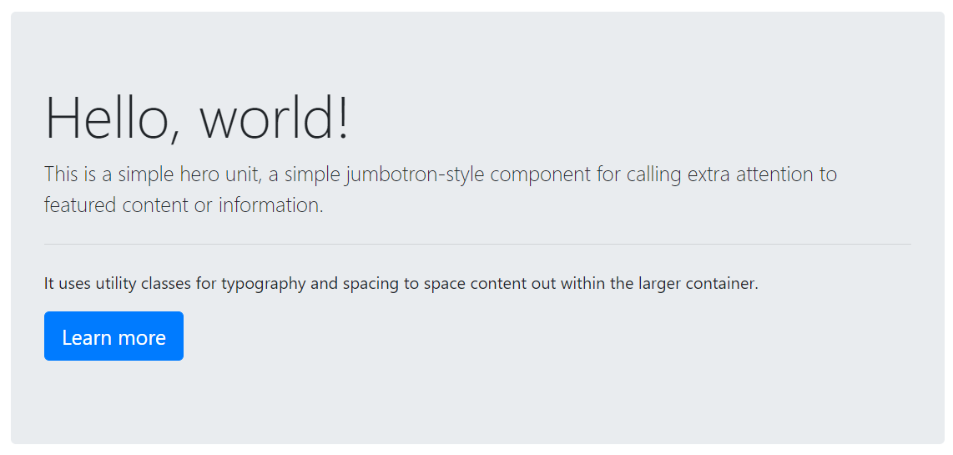
Jumbotron
Lightweight, flexible component for showcasing hero unit style content
<div class="jumbotron">
<h1 class="display-4">Hello, world!</h1>
<p class="lead">This is a ...</p>
<hr class="my-4"><p>It uses ...</p>
<p class="lead">
<a class="btn btn-primary btn-lg">
Learn more</a>
</p>
</div>
See more at: https://getbootstrap.com/docs/4.0/components/jumbotron/

Slide 38


Summary
JavaScript supports conditional statements and loops
JavaScript objects hold key-value pairs
jQuery is a fast, small, and feature-rich JavaScript library that can easily manipulate HTML documents

Slide 39
https://softuni.bg/trainings/courses

Slide 40












SoftUni Diamond Partners

Slide 41




SoftUni Organizational Partners

Slide 42




Trainings @ Software University (SoftUni)
Software University – High-Quality Education and Employment Opportunities
softuni.bg
Software University Foundation
http://softuni.foundation/
Software University @ Facebook
facebook.com/SoftwareUniversity
Software University Forums
forum.softuni.bg

Slide 43

License
This course (slides, examples, demos, videos, homework, etc.) is licensed under the "Creative Commons Attribution-NonCommercial-ShareAlike 4.0 International" license

